Slide 1
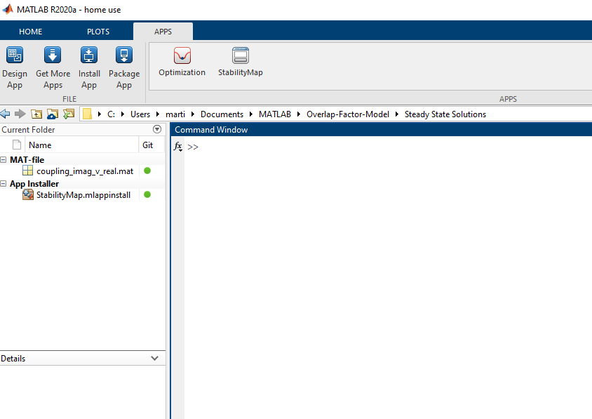
App installed here – double click to run
Double click this to install app

